Slide 1
Navigating the New System for Award Management (SAM)
August 12, 2021

Slide 2
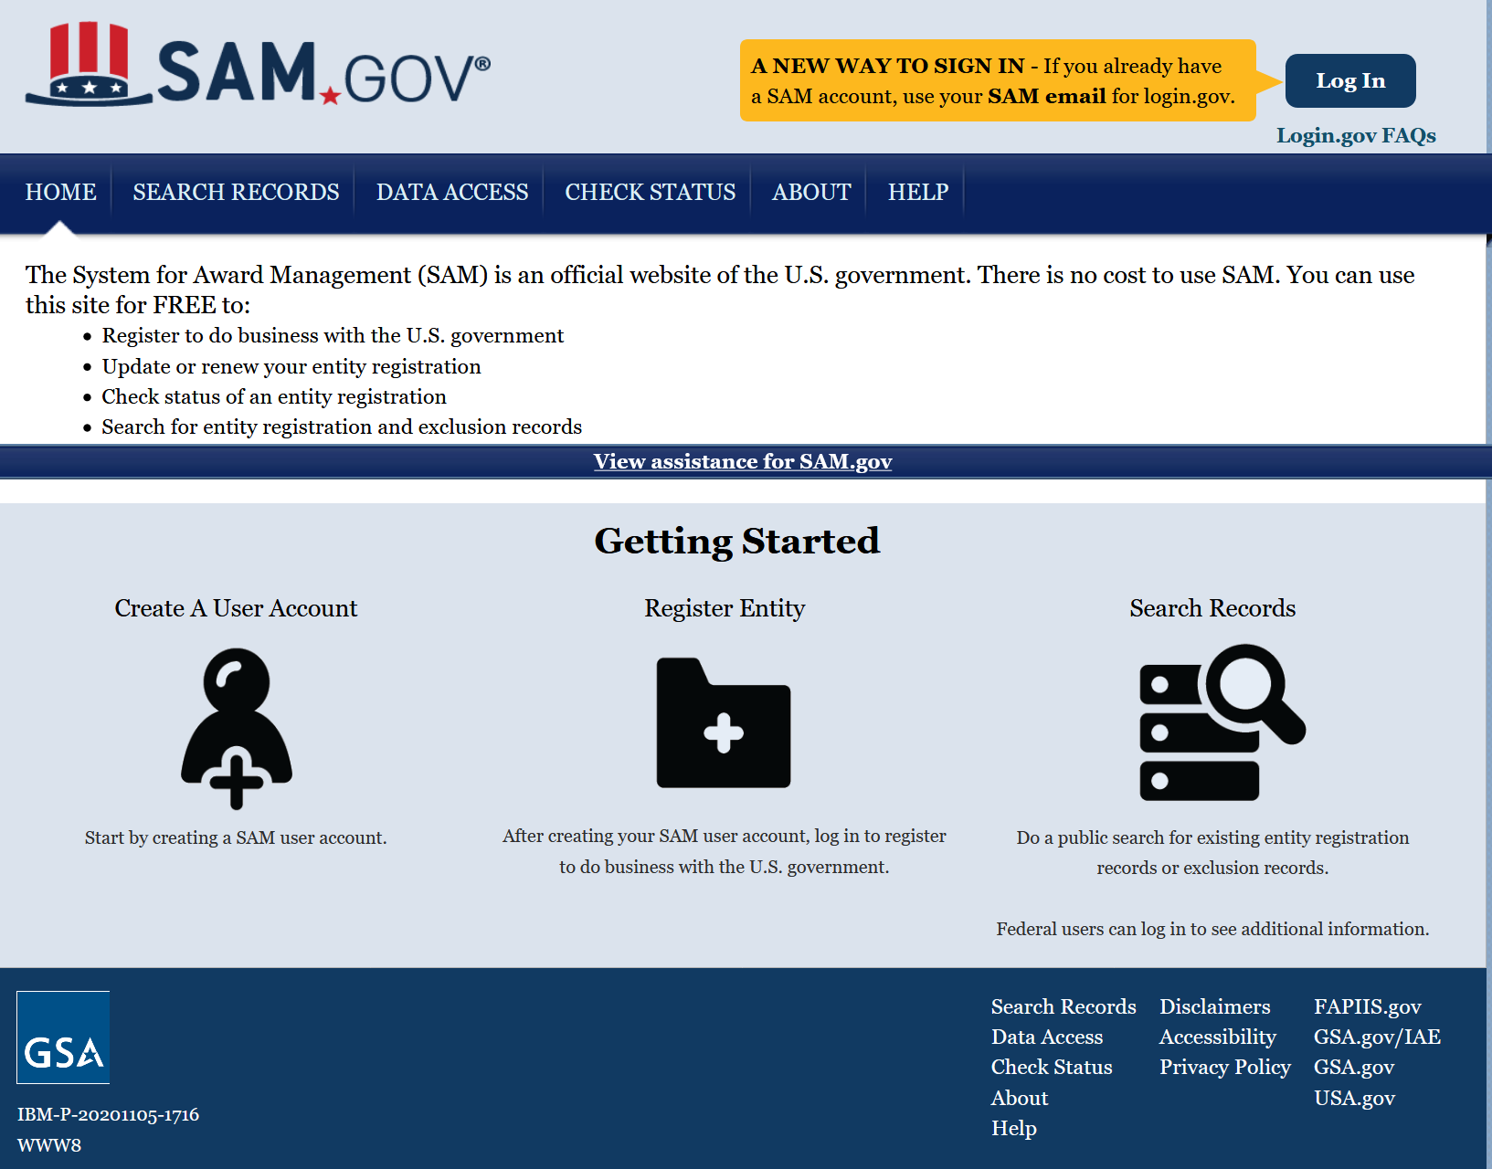
Legacy SAM prior to May 24, 2021

Slide 3
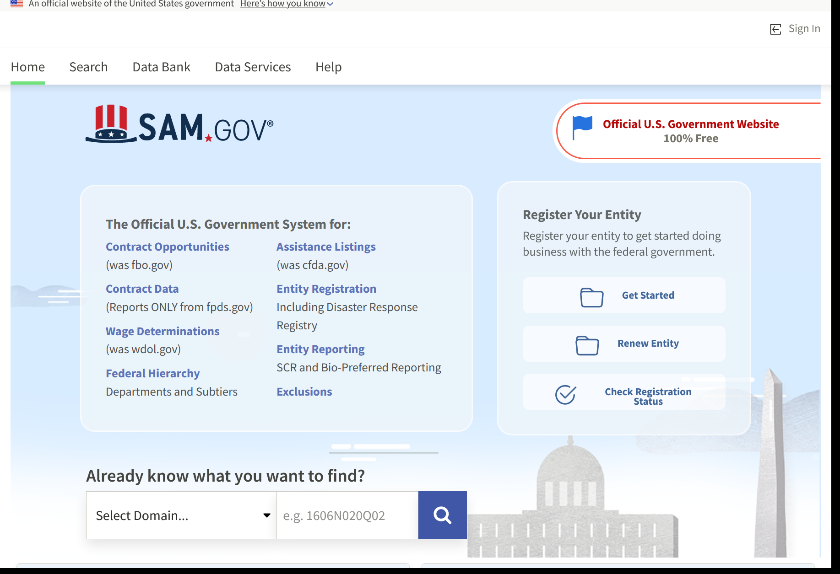
New Interface for SAM

Slide 4
New Interface for SAM
Select Domain to Search

Slide 5
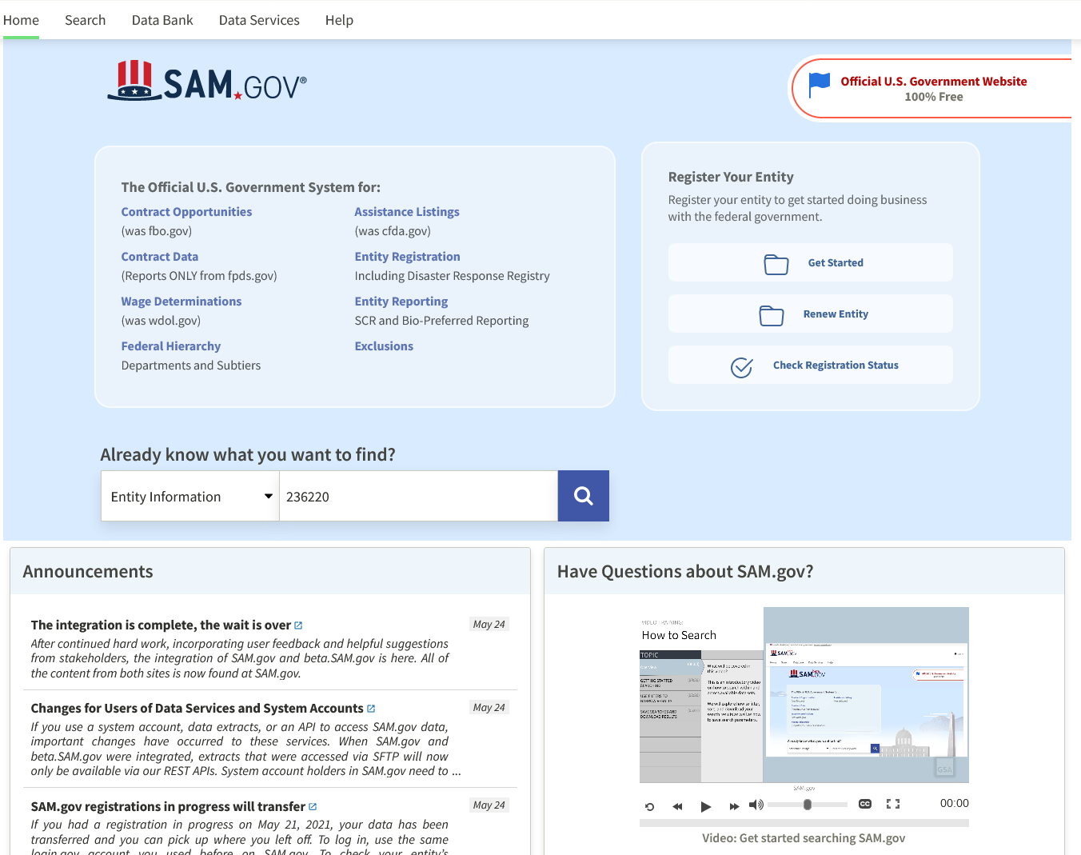
Why Can’t I See Public Entity Data?
Enter NAICS Code or key word and Click

Slide 6
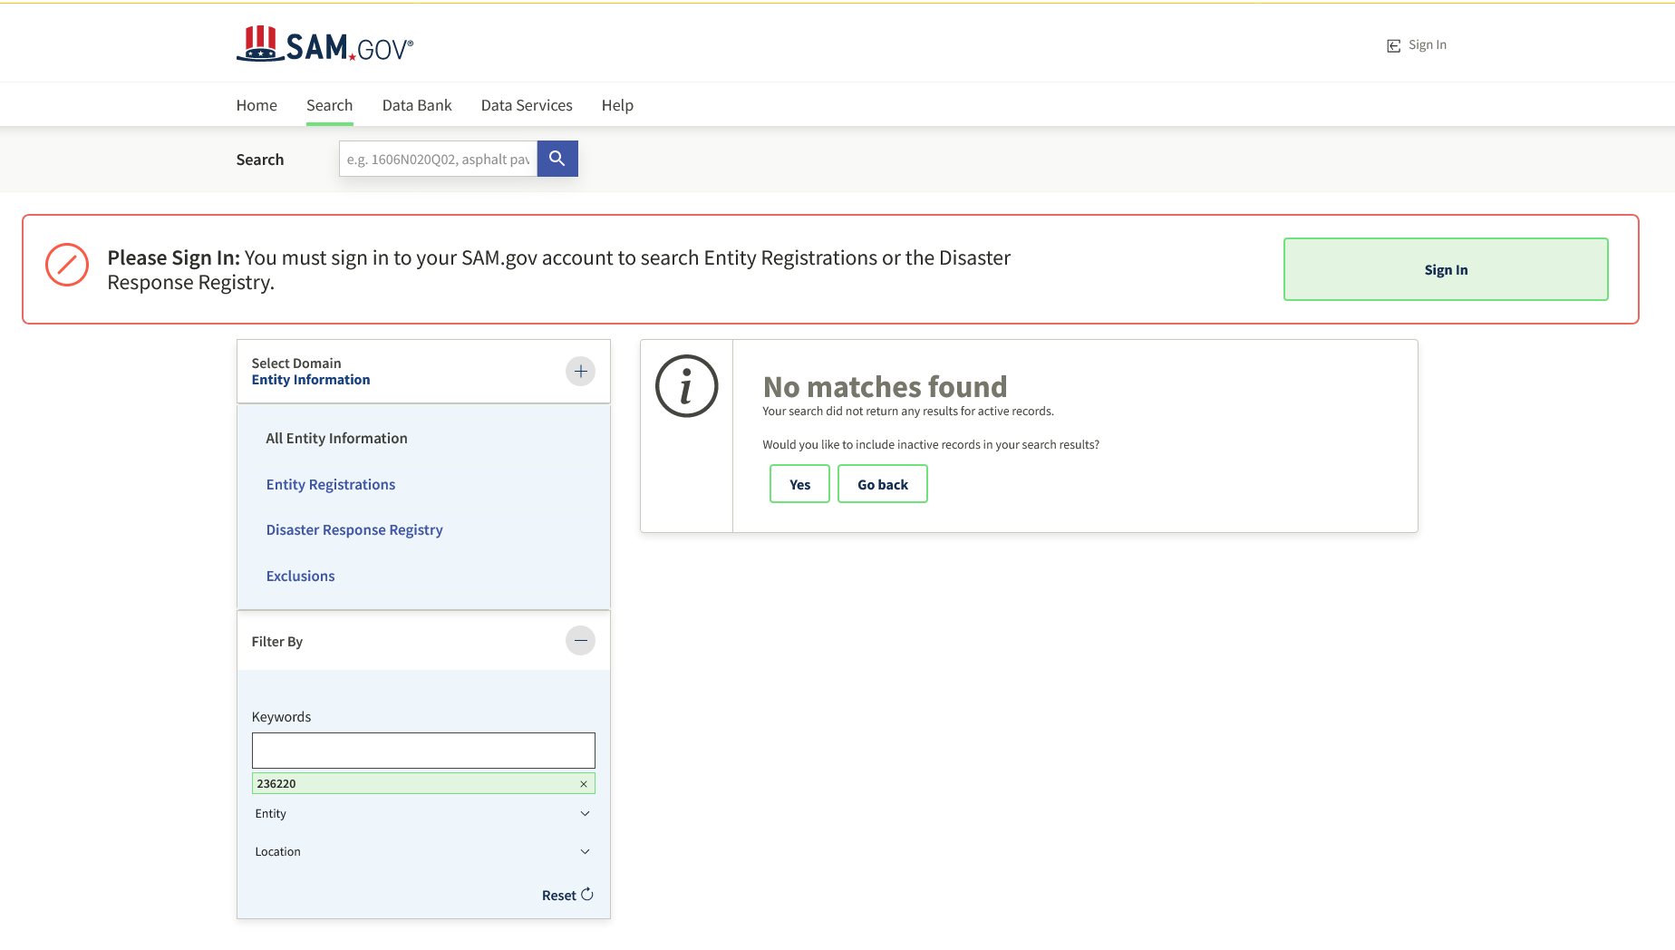
Opps…. Results?? No matches……
For any user to search or view entity registration data, you must be logged in.
There are no roles required to view public data.

Slide 7
https://sam.gov/
Start here for new Entity Registrations

Slide 8
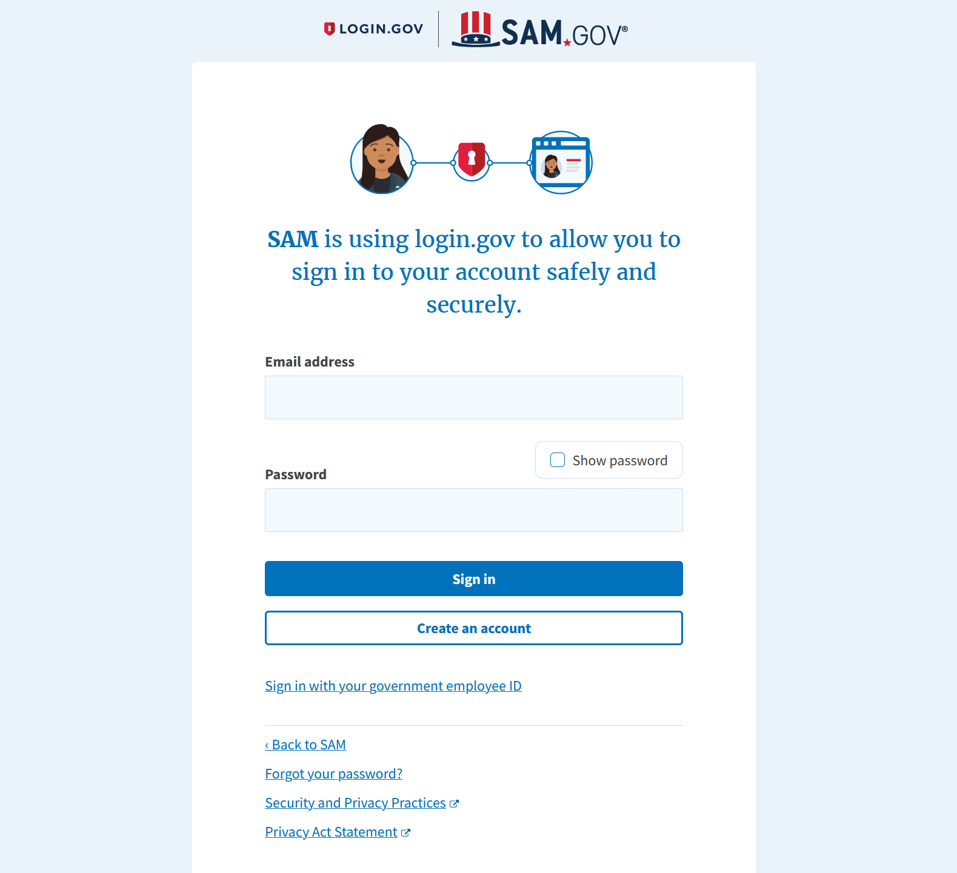
LOGIN.GOV
New Registration in SAM.

Slide 9
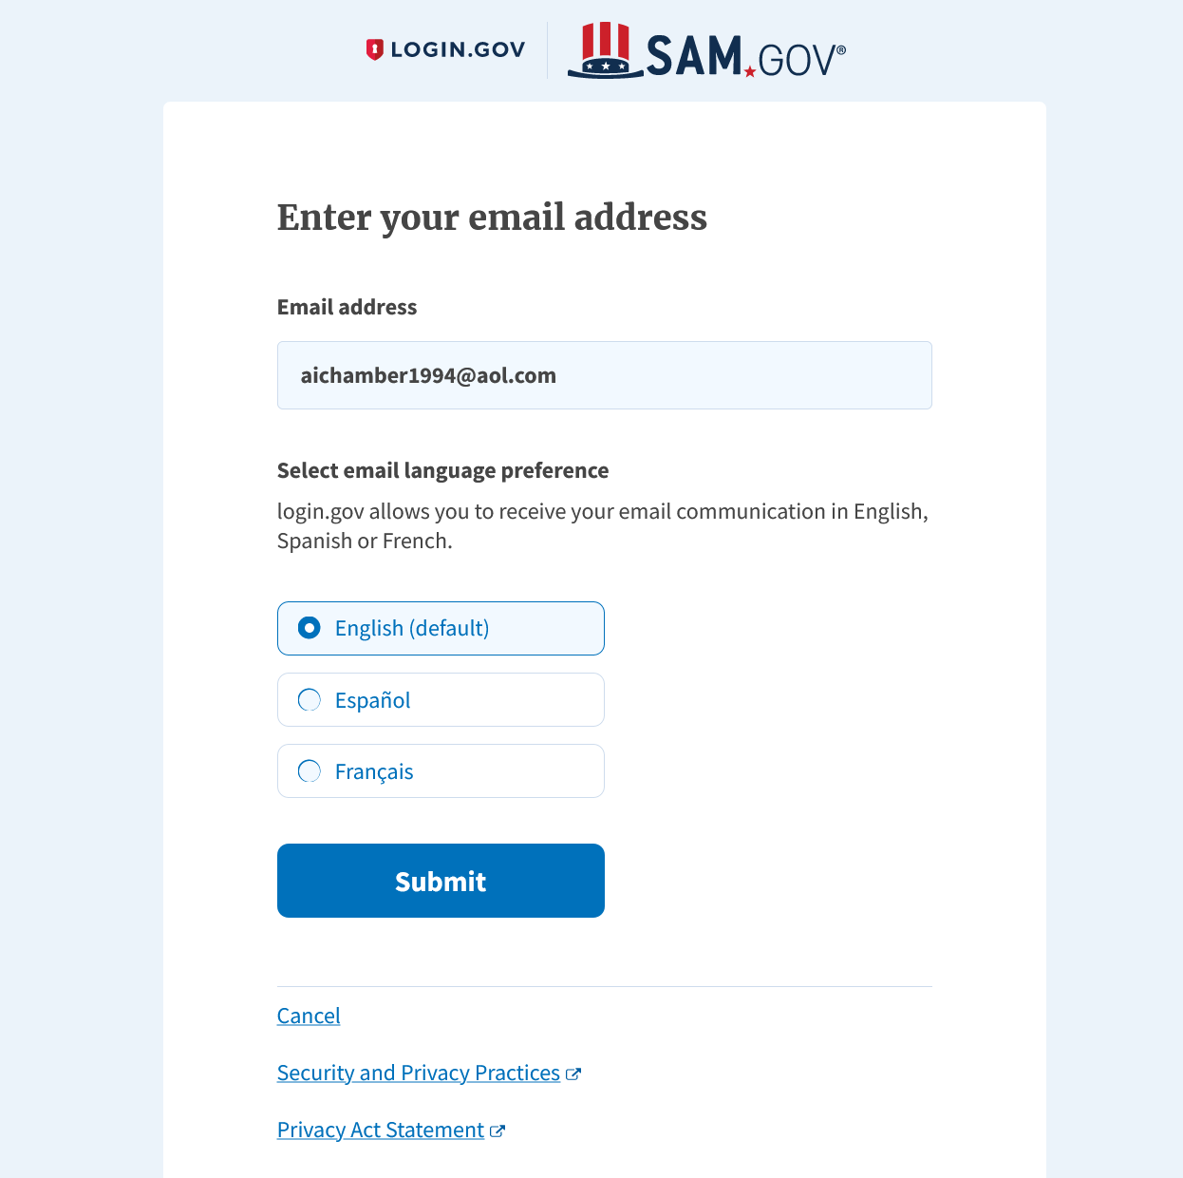
Enter an Email Address
americanindian1994@aol.com
Enter Email used to set up account
Click “Submit”

Slide 10
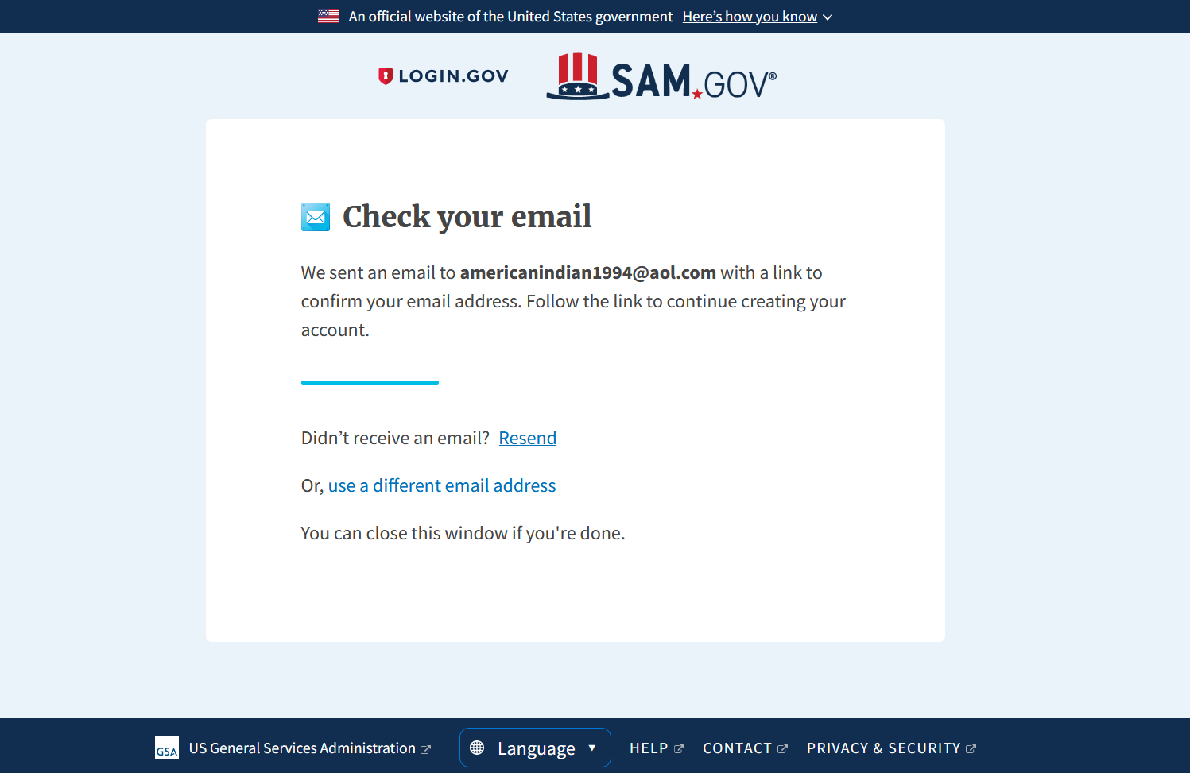
Check Email Notification
Check your email
to complete new registration process

Slide 11
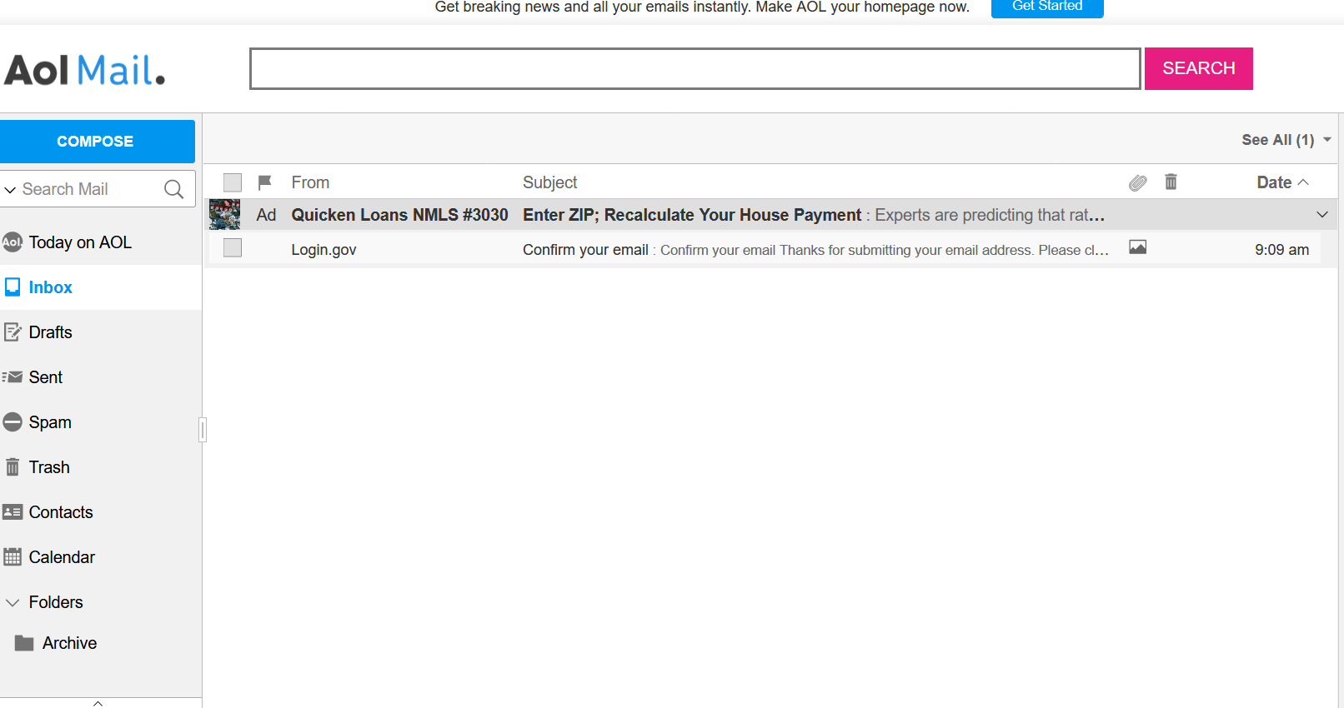
Check Email Confirmation
Check your email to complete “New” registration process from Login.gov

Slide 12
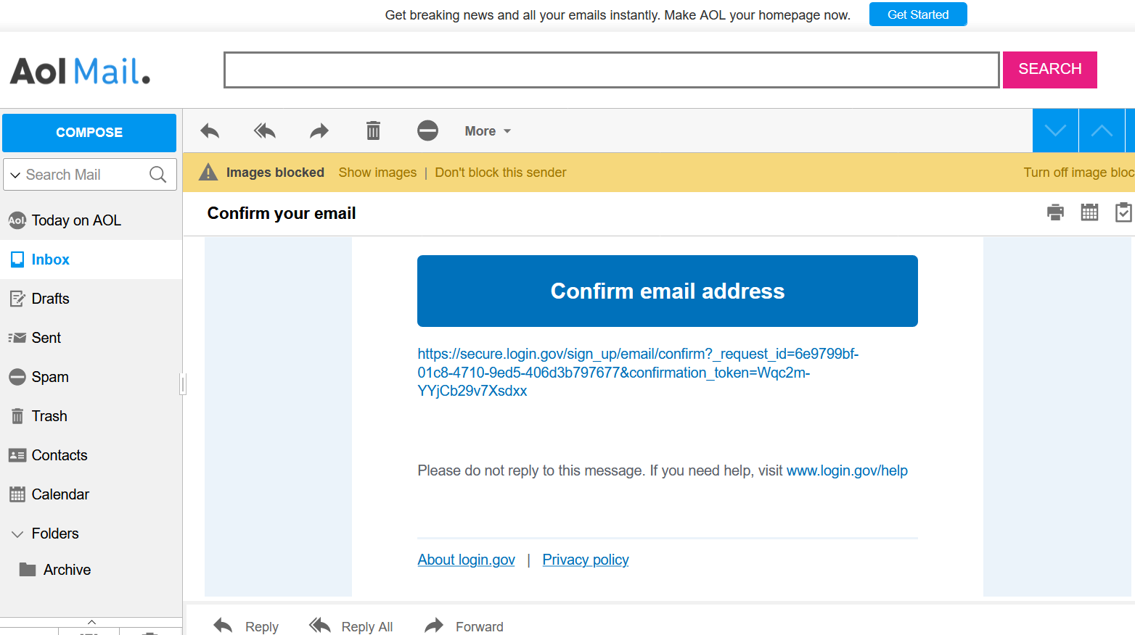
Confirm Email Address
To complete the Registration Request, You need to Confirm your email.
*Note:
This email address will be connected to the registration of your SAM Profile

Slide 13
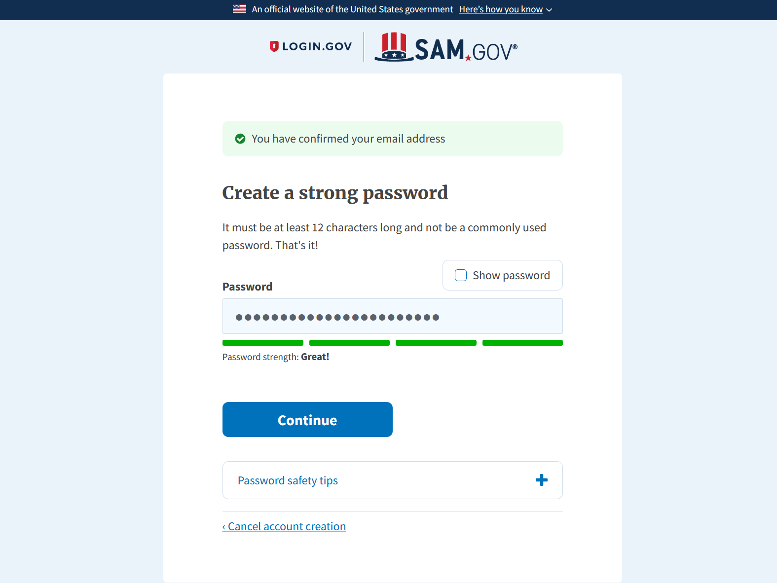
Create a Strong Password
Password Strength must be “good” or “great” to proceed to the next screen.

Slide 14
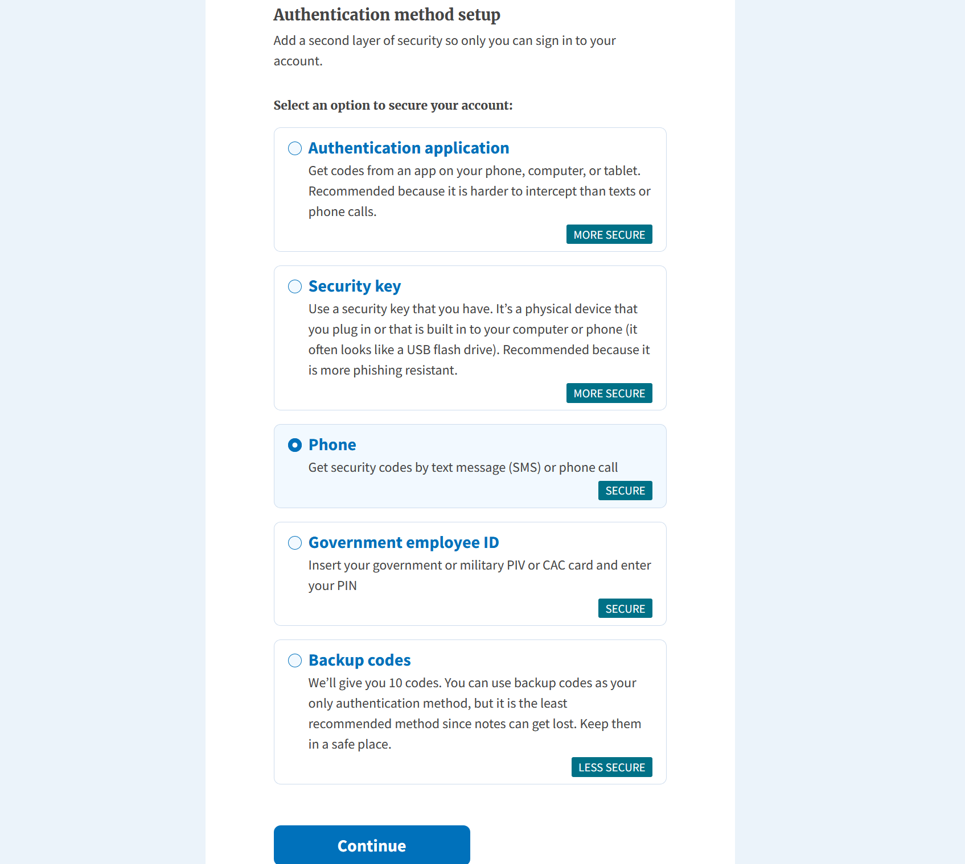
Set up a Second Authentication Method
You have the choice of the second method of Authentication

Slide 15
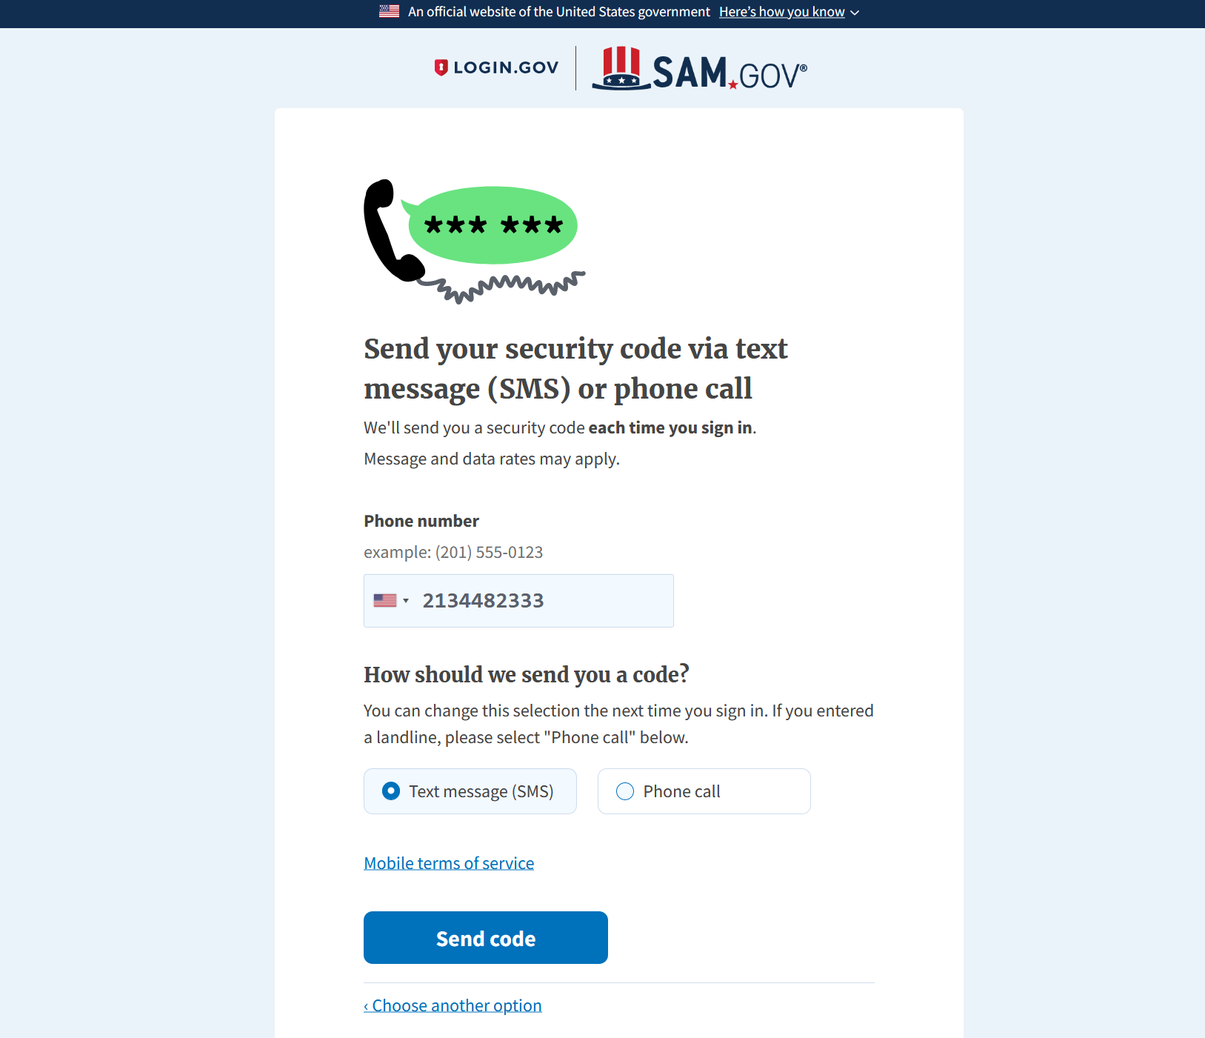
Enter Phone Number
Enter a phone number.
Hit “Send code”

Slide 16
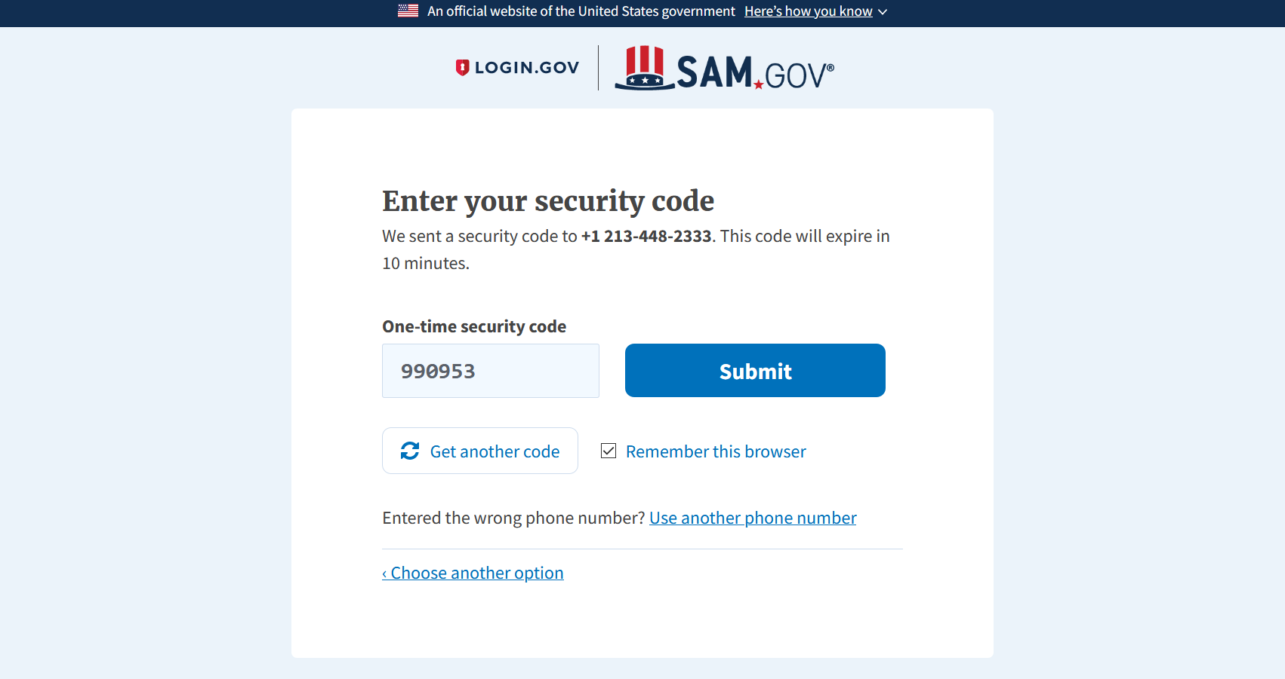
One Time Security Code
Enter one time security code
Click “Submit”

Slide 17
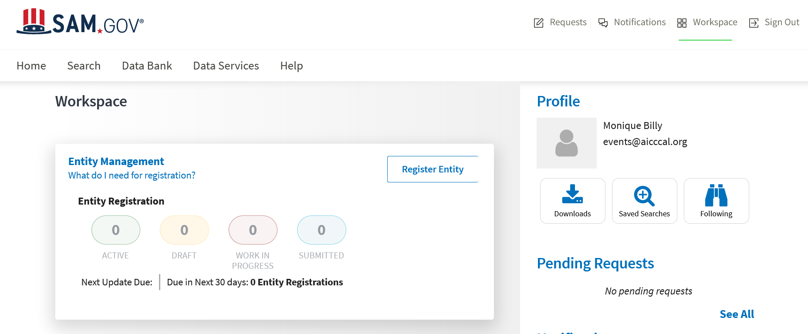
https://sam.gov/
Select “Search”
Select “Search”

Slide 18
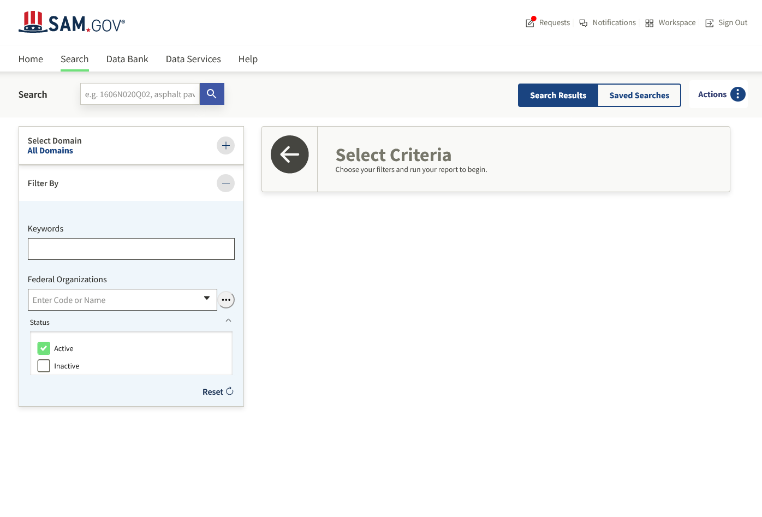
https://sam.gov/
If you enter a keyword, it will show everything that matches the keyword.

Slide 19
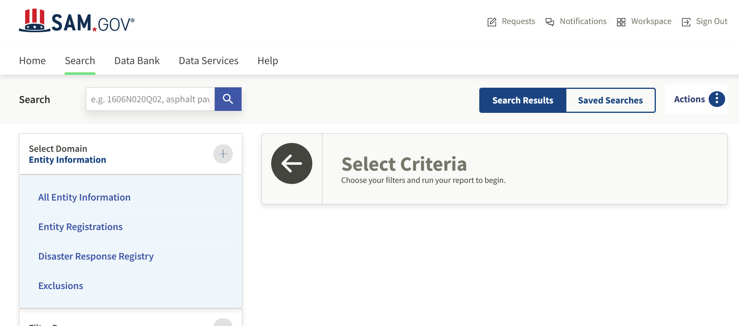
https://sam.gov/
Select the “+” sign.
Select “Entity Registrations” Domain.

Slide 20
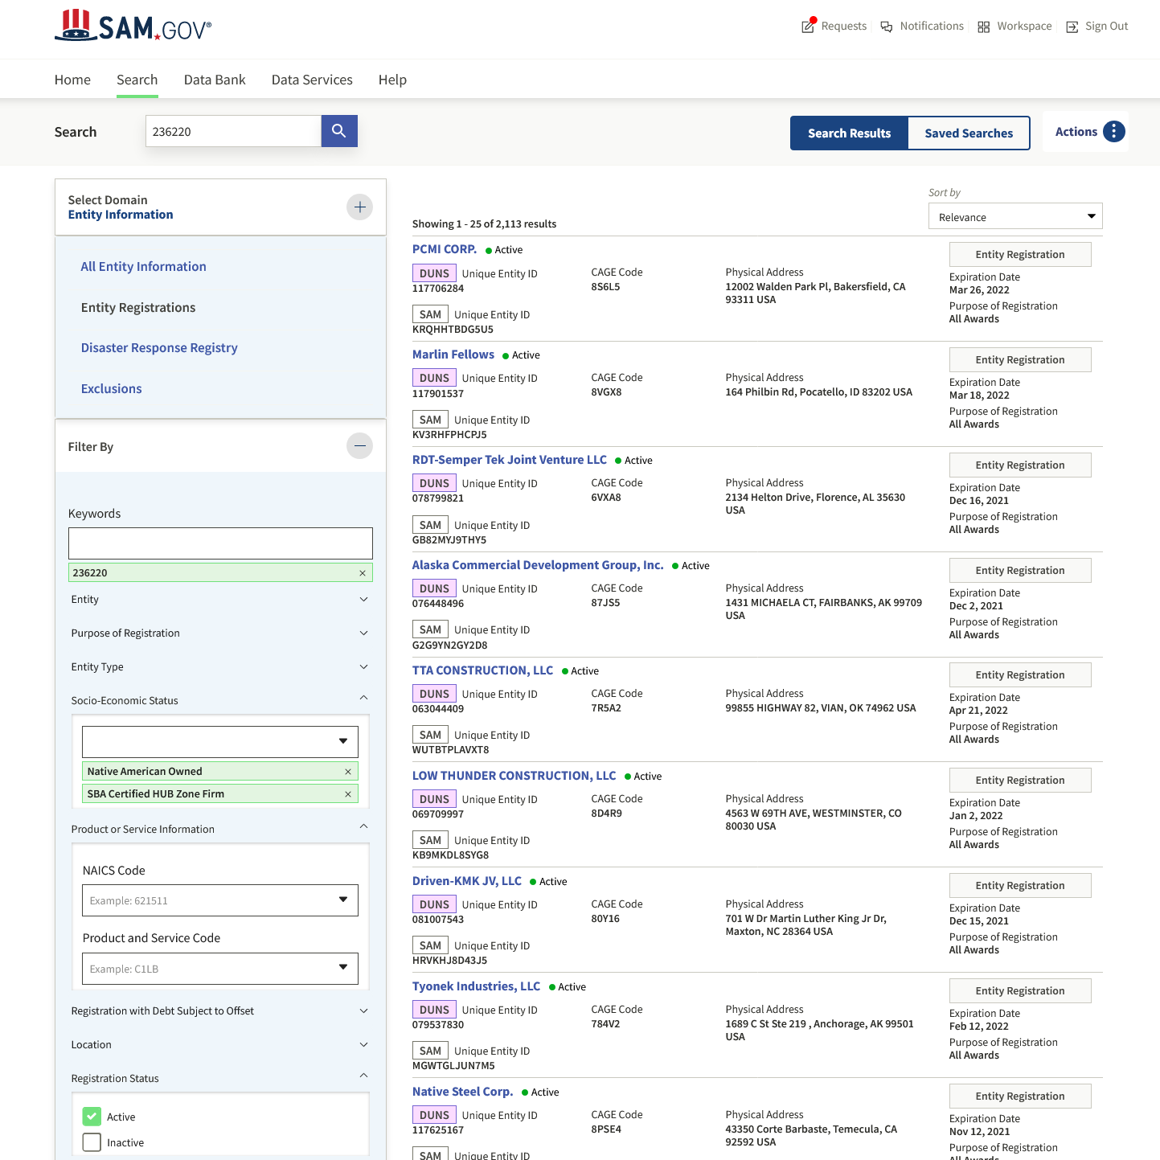
Search by
key word
Search by Socio-Economic Status

Slide 21
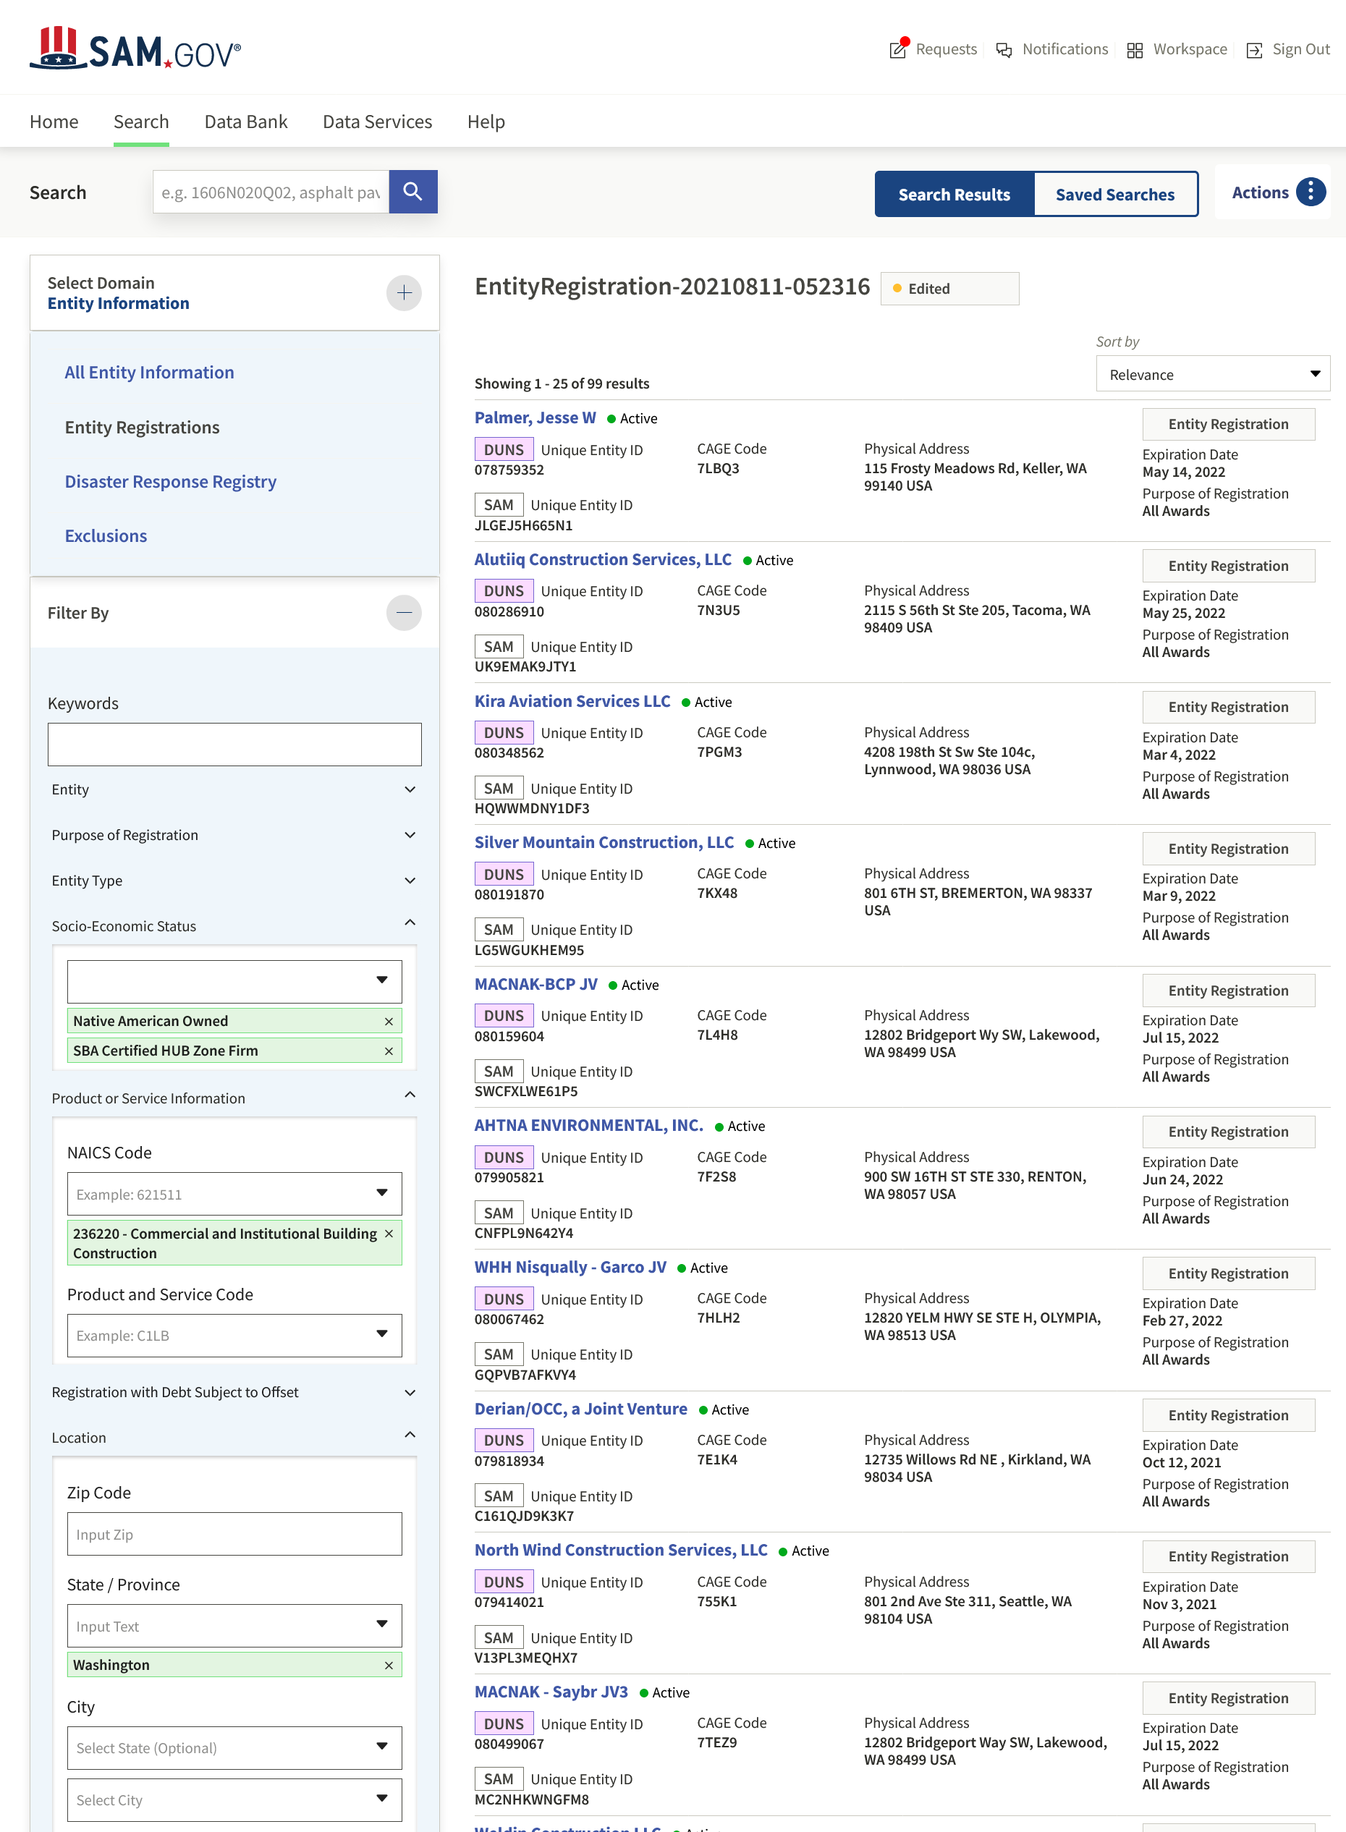
The number of Entity Registrations decreased from 2,113 to 99
To be more specific, you can choose State

Slide 22
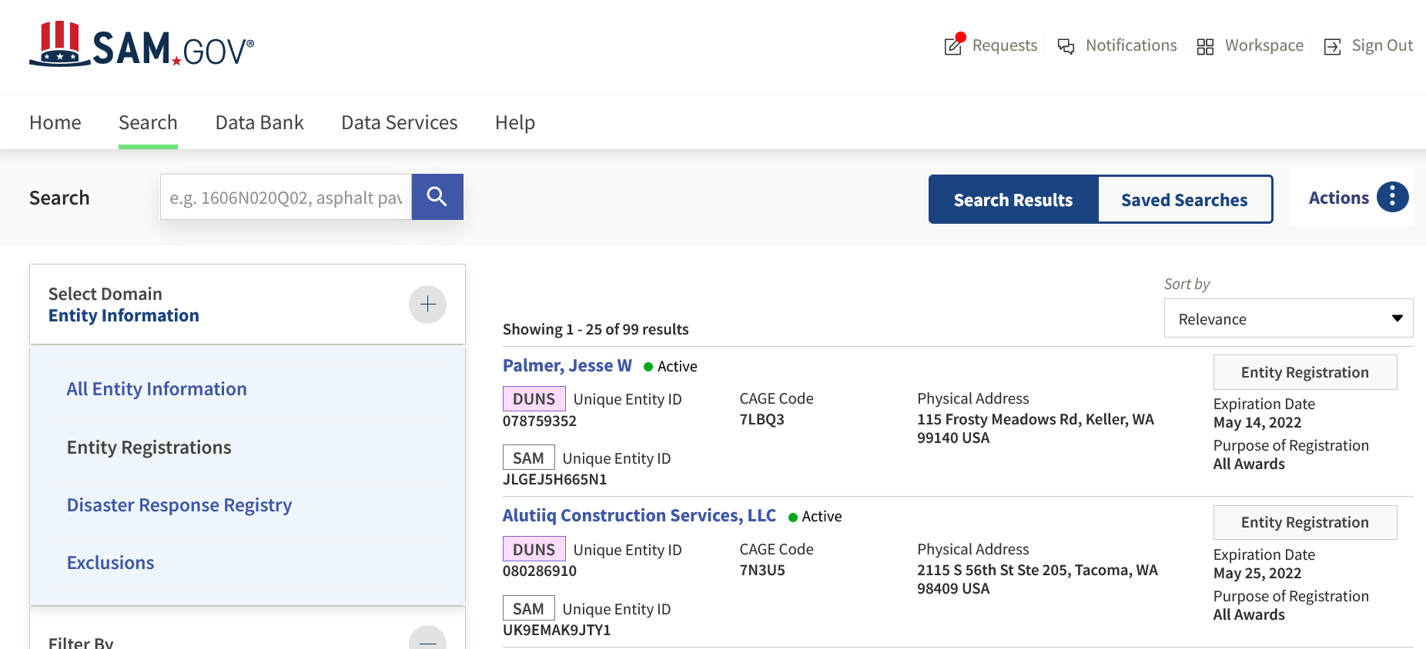
https://sam.gov/
Select the Action symbol to download a report

Slide 23
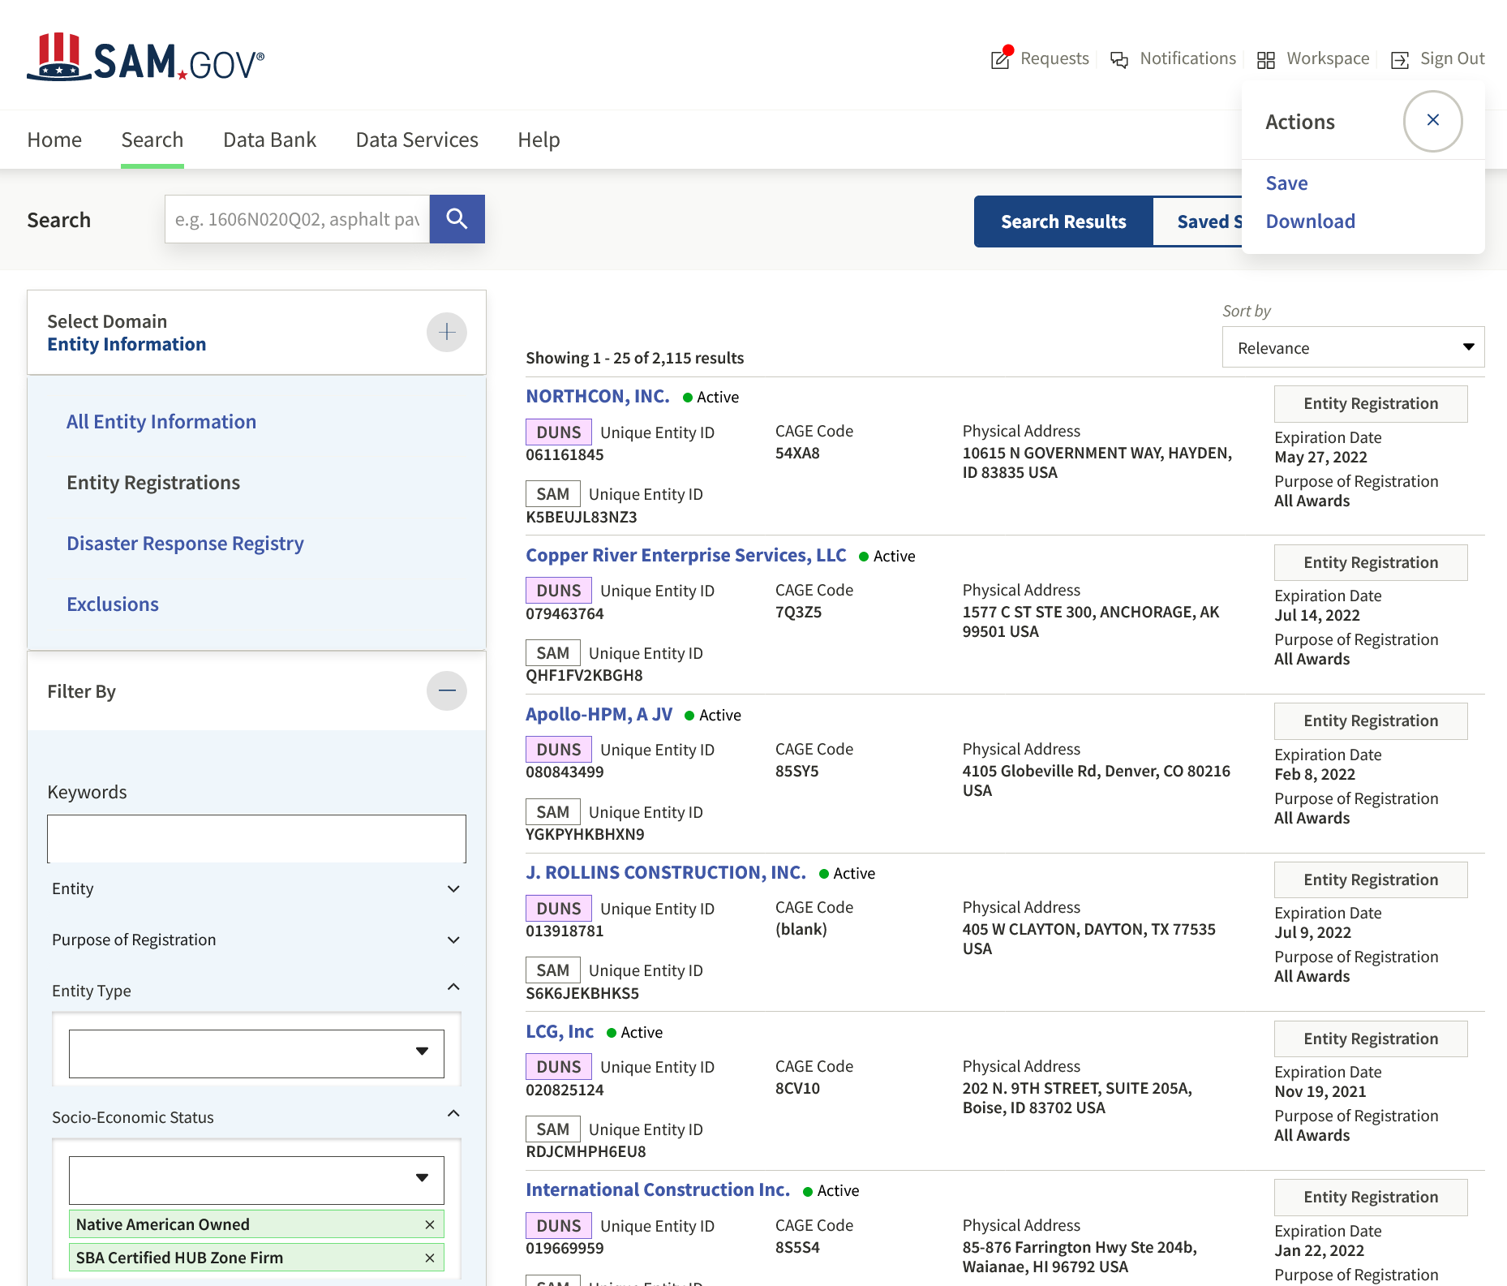
How to Download File
Choices to download a file.

Slide 24
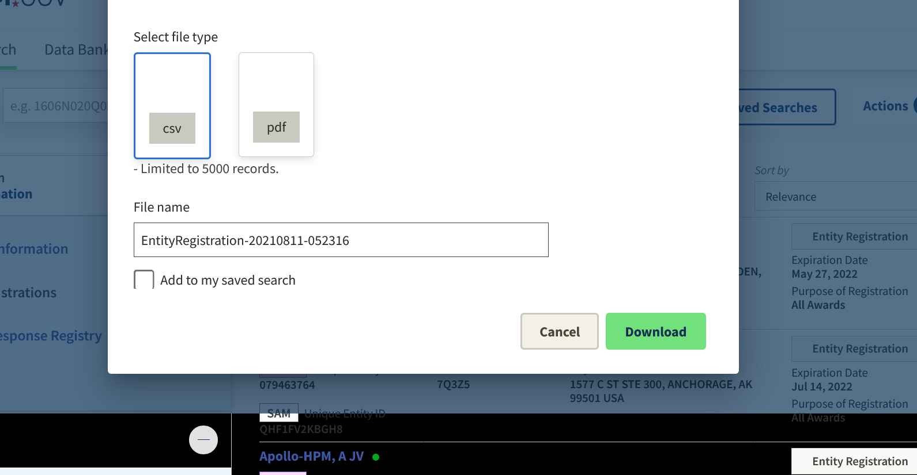
New Interface for SAM
Excel spreadsheet allows you to sort and delete as necessary

Slide 25
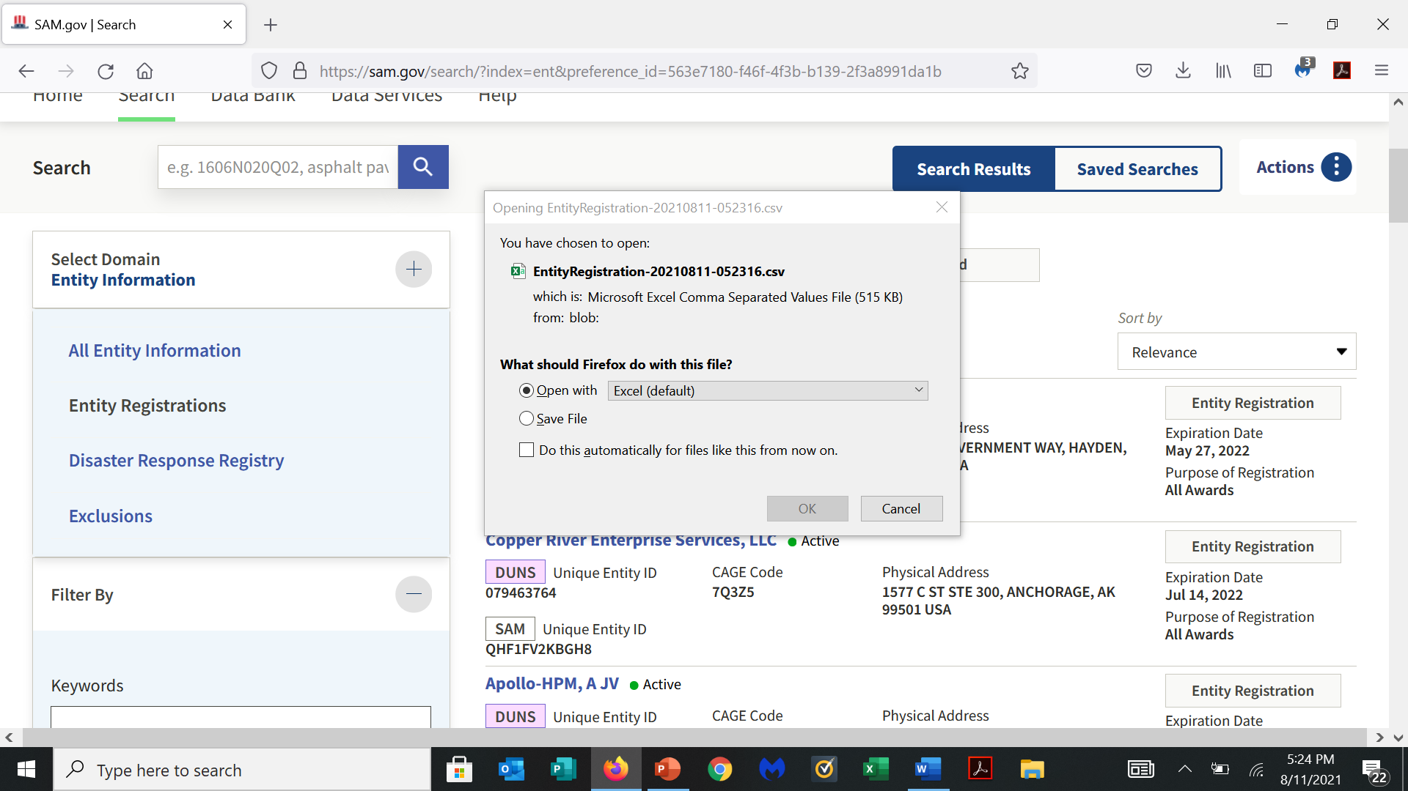
Prompts to Open file or Save file

Slide 26
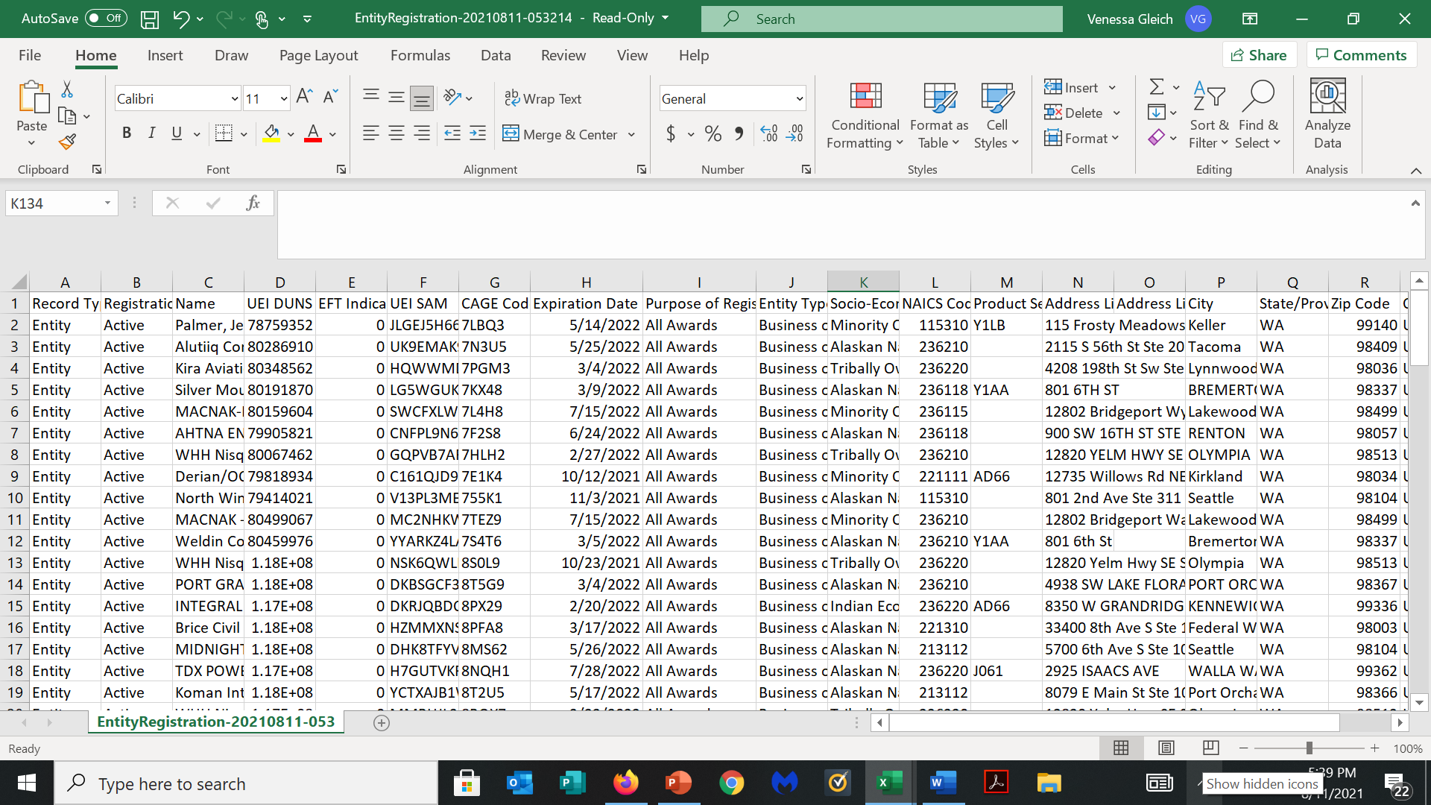
Downloaded Entity Registration

Slide 27
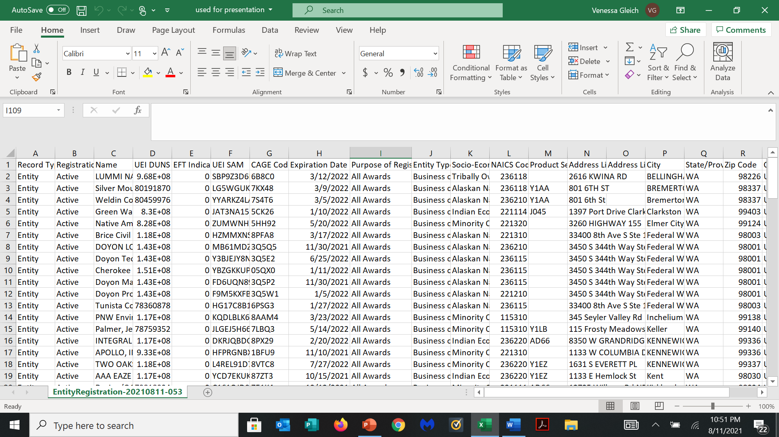
Entity Registration’s sorted by City

Slide 28
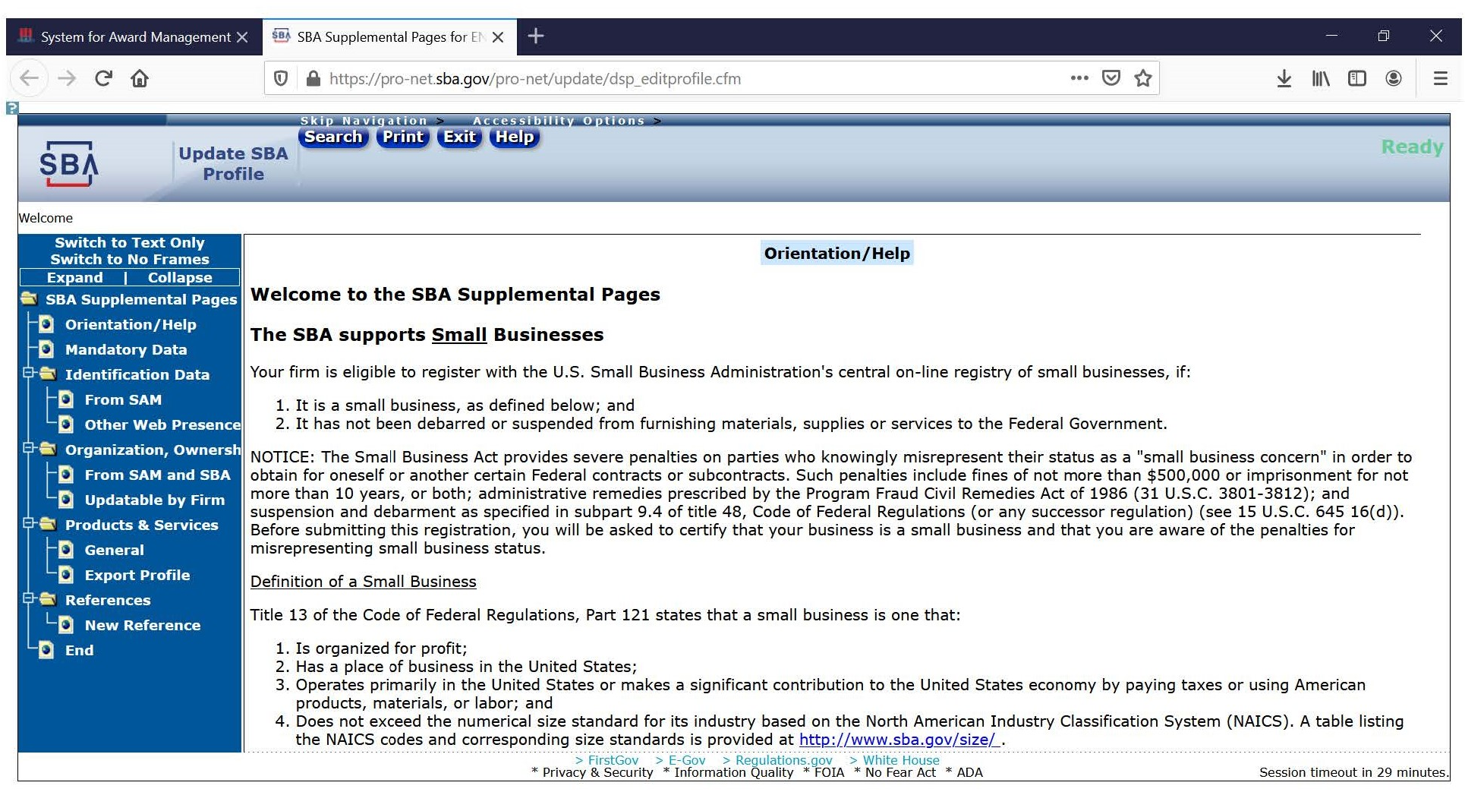
Dynamic Small Business Search

Slide 29
QUESTIONS

